Slide 1

Armed Forces College of Medicine
AFCM

Slide 2
liver cirrhosis & sequel 1
By
Ass. Prof. Ahmed Elshafie
lecturer Dr. Yasser Omar
Revised by Mervat Behiry

Slide 3
Indented Learning Outcomes (ILOs)
By the end of this lecture you will be able to:
Define Liver cirrhosis & identify different etiology.
Identify different complications of liver cirrhosis.
Recognize the management of acute variceal bleeding.
Recognize how to diagnose& manage spontaneous bacterial peritonitis,

Slide 4
Abd-Elsamad Mohamed, male patient, 45 years old, farmer. He complaint from dull-aching pain in right hypochondrium. He sought medical advice. Laboratory investigations showed ALT 66 U/L, AST 60 U/L, Total bilirubin 1.5 mg/dl & Alk. Phosph. 59 U/L. Abdominal ultrasound revealed Liver cirrhosis.

Slide 5
What is liver cirrhosis?

Slide 6
Liver cirrhosis: Definition
Cirrhosis is a consequence of chronic liver disease, characterised by progressive replacement of liver tissue by fibrosis, scar tissue and regenerative nodules leading to loss of hepatic architecture and loss of liver function.

Slide 7
Liver cirrhosis: Etiology
[A] Main causes
- HCV
- HBV
- Alcoholic Liver disease
- NAFLD

Slide 8
Liver cirrhosis: Etiology (Cont.)
[B] Other causes of liver cirrhosis < 2%
Cholestatic & autoimmune liver diseases | Intrahepatic or extrahepatic biliary obstruction
1^{ry} biliary cholangitis 1^{ry} sclerosing cholangitis Autoimmune hepatitis | Mechanical obstruction Biliary atresia Cystic fibrosis
Metabolic inherited disorders | Hepatic venous outflow obstruction
Hemochromatosis Wilsons disease α₁-antitrypsin deficiency Glycogen storage diseases Abetalipoproteinemia Porphyria | Budd-Chiari syndrome Veno-occlusive disease Right-sided heart failure
 | Drug & toxins
 | Intestinal bypass
 | Indian childhood cirrhosis

Slide 9
Early clinical manifistations
Asymptomatic in 30-40%
Aching or heaviness in right upper quadrant.
Weakness & fatigue.
Anorexia, nausea, indigestion, weight loss.

Slide 10
Investigations for the patient at this stage
A- Laboratory tests to Assess Liver damage and functions:
- Liver enzymes: ALT, AST, Alk. Phosph., γ-GT.
- Total and direct bilirubin.
- Serum albumin.
- PT & PTT.
- CBC: to detect anemia, thrombocytopenia, leukopenia.

Slide 11
Investigations for the patient at this stage (Cont.)
B- To investigate the etiology:
- HBV, HCV, HDV serology.
- Lipid profile.
- AMA, ANA, SMA, LKM.
- Serum iron, ferritin, TIBC.
- Copper, ceruloplasmin, urine copper.
- α1-antitrypsin level.

Slide 12
Investigations at this stage (Cont.)
C- Diagnosis of Liver cirrhosis:
- Liver biopsy (Gold standard – seldom used): usually is performed if etiology isn't reached by non-invasive tests
- Imaging by ultrasonography, CT, or MRI of an irregular and nodular liver together with impaired liver synthetic function is sufficient for the diagnosis of cirrhosis.
- Transient elastography (Fibroscan)
- Non-invasive markers?!

Slide 13
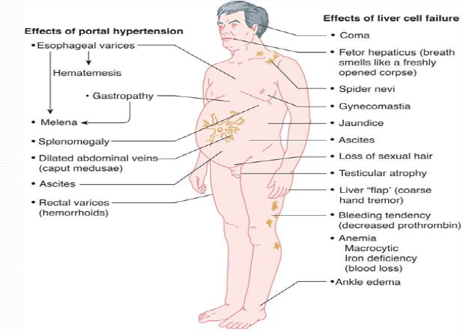
Silky hair
B
A
Parotid enlargement
Clinical consequences of liver cirrhosis

Slide 14
Three years later, Abd-Elsamad had a syncopal attack and transferred to ER, his vital data [BP: 90/60, pulse: 110, RR: 19, Temp: 37]. From history, he noticed change in stool (soft black tarry stool with offensive odour). What is the first step in management?
1- Sengstaken tube insertion
2- Ryle tube insertion and gastric wash
3- Vascular access
4- Upper GI endoscopy
5- Colonoscopy

Slide 15
Portal hypertension (PHT)
- Portal pressure (PP) is assessed by the hepatic venous pressure gradient (HVPG) (pressure gradient between the Wedged hepatic venous pressure and the free hepatic venous pressures ).
- An HVPG of ≥5 mmHg defines portal hypertension.
- Clinically significant PHT if HVPG ≥10 mmHg.
- HVPG ≥ 12 mm Hg, variceal haemorrhaging may occur.

Slide 16
Causes of PHT according to site of pathology
Portal hypertension
Postsinusoidal
Extrahepatic
Intrahepatic
Sinusoidal
Presinusoidal
Extrahepatic
Intrahepatic

Slide 17
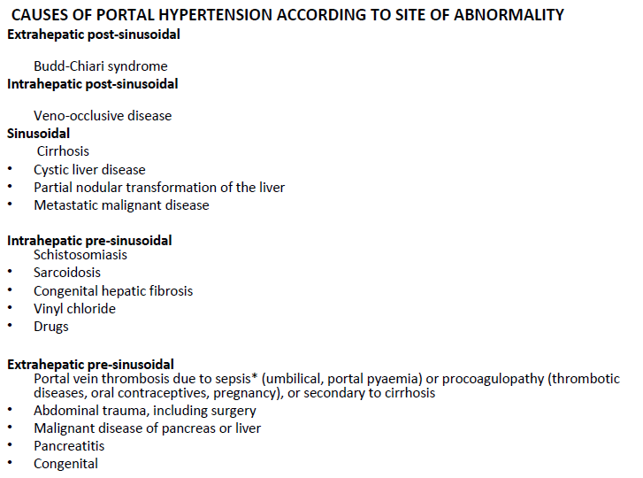
Causes of PHT according to site of pathology

Slide 18
Clinical complications of PHT
Increased resistance to portal blood flow + hyperdynamic circulation → formation of porto- systemic collaterals that diver blood to systemic circulation bypassing the liver.
VARICES: esophageal, gastric, gastroduodenal, anorectal, retroperitoneal.
Portal hypertensive gastropathy and colopathy.
Caput medusae
Congestive splenomegaly
Hepatic encephalopathy
Ascites

Slide 19
Acute GI bleed + portal hypertension
Airway
Breathing
Circulation: 2 wide pore cannula & blood samples
Volume replacement with colloids and/or crystalloids should be initiated.
Restrictive transfusion is recommended in most patients (Hb threshold, 7 g/dl; target range 7–9 g/dl)
Initial assessment and resuscitation
Immediate start of vasoactive drugs
Antibiotic prophylaxis
Gastric lavage
Early diagnostic Endoscopy (<12 hours)
Balloon tamponade or oesophageal stenting
(if massive bleeding, transient till endoscopy)
ENDOSCOPY
Confirm variceal bleeding
ENDOSCOPY
Endoscopic band ligation/sclerotherapy
+
Maintain drug therapy for 3–5 days and antibiotics
Control
(~85% of cases)
Further bleeding
(~15% of cases)
Consider early TIPS in high risk for early recurrence
Rescue with TIPS

Slide 20
Treatment of Acute Variceal Hemorrhage
- Blood samples (for cross matching, CBC, electrolytes, renal function and bleeding profiles).
- Antibiotic prophylaxis: 3rd generation -(ceftriaxone IV 1gm/24 hours).
- Vasoactive drugs that decrease splanchnic blood flow: terlipressin, somatostatin and octreotide analogues.
- Endoscopic therapy: band ligation (for esophageal varices only), sclerotherapy (mainly for gastric varices & may be used for esophageal varices).

Slide 21
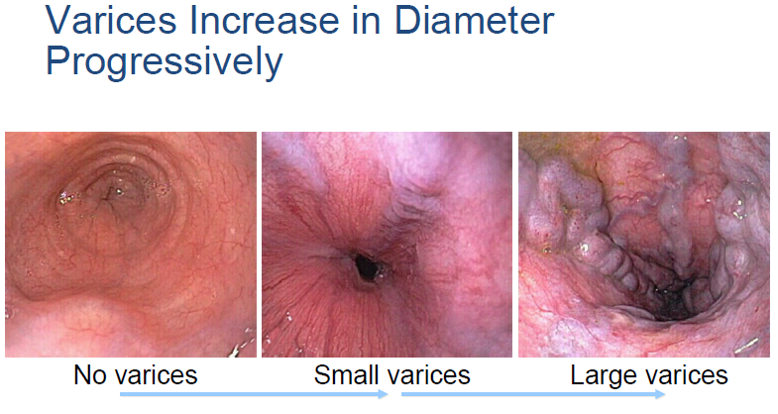

Slide 22
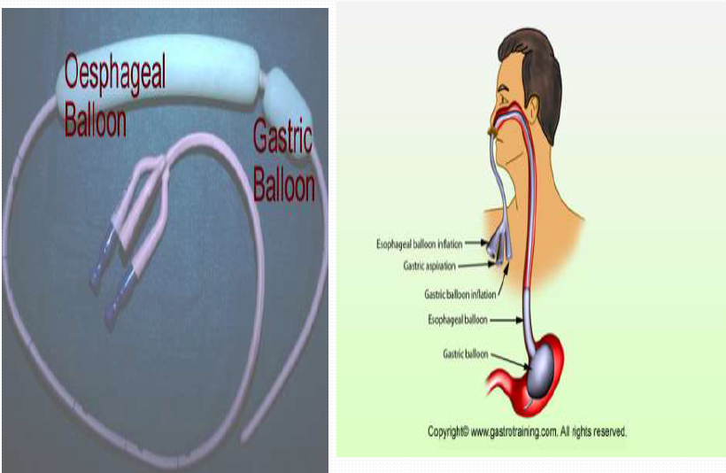
SENGSTAKEN-BLACKMORE TUBE

Slide 23
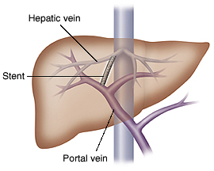
Transjugular intrahepatic portosystemic shunt (TIPS)
- It is radiological intervention
- Complications: hepatic encephalopathy.
- Contraindicated in severe liver dysfunction.
- Commonly used as a bridge to liver transplantation
TIPS

Slide 24
Risk of Acute GI bleeding
Acute GI bleeding in patient with cirrhosis carries high rate of complications and mortality.
Prevention of variceal bleeding Is very important

Slide 25
Prevention of Variceal bleeding
Primary prophylaxis: prevent 1st episode of bleeding
Secondary prophylaxis: prevent recurrent episodes of bleeding
- Patients with Decompensated cirrhosis (DC) are at high risk of varices development → should have screening OGD for varices detection, unless previously diagnosed and treated.
- In patients without varices in whom etiological factor persists and/or remain decompensated, screening OGD should be repeated yearly

Slide 26
Method of prophylaxis
[A] Medications: Non selective Beta blocker (Nadolol, Propranolol) – Nitrates.
[B] Endoscopy: Sclerotherapy and variceal ligation.
- For 1ry prophylaxis: Either NSBBs or EBL are equally effective in preventing first bleeding in patients with high-risk varices.
- For 2ry prophylaxis: NSBBs and EBL in combination reduces the risk of re-bleeding compared with monotherapy.

Slide 27
After five months, Abd-Elsamad noticed both lower limb swelling and then develop abdominal distension. Clinical examination revealed increase abdominal girth and shifting dullness.
What is appropriate management?
1- Diuretics
2- Large volume paracentesis
3- Sodium restriction
4- All of above
5- 1 & 3

Slide 28
Ascites
It is fluid accumulation within peritoneal cavity.
Cirrhosis is responsible for 80% of cases of ascites.
Patients with ascites should be considered for referral for LT.

Slide 29
Ascites: Grading
Ascites is graded based on amount of fluid in the abdominal cavity.
Grading of ascites*
Grade 1 | Mild ascites: only detectable by ultrasound examination.
Grade 2 | Moderate ascites: manifest by moderate symmetrical distension of abdomen detected clinically by shifting dullness percussion.
Grade 3 | Large or gross ascites: provokes marked abdominal distension; if tense detected clinically by fluid thrill method.
Development of ascites in patients with cirrhosis (grade 2 or 3) is associated with a poor prognosis:
- 1-year mortality: 40%
- 2-year mortality: 50%

Slide 30
Ascites: Initial patient evaluation
History: ask about symptoms of liver, renal, & cardiac diseases.
Physical examination:
General: features of liver cell failure
Local abdominal examination:
- Inspection: Generalized distention of abdomen with fullness of flanks. Divarication of recti. Stretched skin & linea alba.
- Palpation: dipping method for deep organ palpation.
- Percussion:
Moderate ascites → Shifting dullness test
Tense ascites → Fluid thrill test = Fluid wave test

Slide 31
Ascites: Investigations
[A] Invest. For the cause
- Abdominal U/S facilitates the early diagnosis of ascites (<200 ml).
- Liver & Renal Function.
- ESR, Urine analysis, Protein/creatinine ratio.
- Echo

Slide 32
Ascites: Investigations (cont.)
[B] Diagnostic paracentesis
Diagnostic paracentesis (50 to 100 mL) should be part of the routine evaluation of the patient with ascites. The fluid should be examined for:
1- Its gross appearance
2- Laboratory analysis
Routine test | Optional tests | Unusual test
Albumin concentration Total protein concentration Cell count & differential Culture in blood culture bottle | Glucose LDH Amylase Gram stain | Cytology Tuberculosis smear and culture Triglycerides Bilirubin

Slide 33
Tests most useful for determining the etiology of ascites
1- Measurements of the serum ascites albumin gradient (SAAG):
SAAG = [serum albumin] – [ascitic fluid albumin]
- The gradient correlates directly with portal pressure.
2- Measurements of ascites total protein.

Slide 34
The serum ascites albumin gradient (SAAG)
SAAG
≥ 1.1 mg/dl
<1.1 mg/dl
Portal hypertension
Non portal hypertension

Slide 35
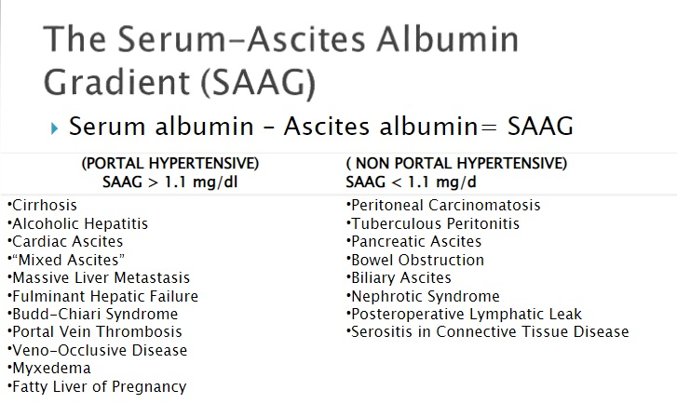
The serum ascites albumin gradient (SAAG)

Slide 36
1st step
SAAG
≥ 1.1 mg/dl
<1.1 mg/dl
Portal hypertension
Non portal hypertension
2nd step
Ascitic total protein
Ascitic total protein
< 2.5 g/dl
≥ 2.5 g/dl
< 2.5 g/dl
≥ 2.5 g/dl
PHT due to cirrhosis
PHT due to hepatic venous outflow obstruction including heart failure
Nephrotic syndrome
Malignancy
Tuberculosis
Others

Slide 37
Management of Uncomplicated Ascites
Definition of uncomplicated ascites: Ascites responsive to diuretics in the absence of infection and renal dysfunction
Grade 1 or mild ascites
No data on evolution and not known if treatment modifies natural history

Slide 38
Management of Uncomplicated Ascites
Grade 2 or moderate ascites
Hospitalization not required
Correct sodium imbalance
Dietary restriction
↑renal excretion with diuretics

Slide 39
Management of Grade 2 Uncomplicated Ascites
[A] Moderate Sodium restriction: (80–120 mmol/day, corresponding to 4.6–6.9 g of salt)
Effective in 10-20% of cases
Very low sodium diets (<40 mmol/day) should be avoided
Predictors of response: moderate ascites, Urine Na excretion > 50 mEq/day

Slide 40
Management of Grade 2 Uncomplicated Ascites (cont.)
[B] Diuretics: Mainstay of medical treatment are anti-mineralocorticoid
Spironolactone 100 mg/day with 100 mg stepwise increased every 72 hrs to a maximum of 400 mg/day if no response
Inadequate weight loss (a body weight reduction of less than 2 kg/week) or if hyperkalemia develops
Add furosemide with spironolactone (from 40 mg/day with 40 mg stepwise increases to a maximum of 160 mg/day).
N.B.: Torasemide can be given in patients exhibiting a weak response to furosemide.

Slide 41
Monitoring diuretic therapy
Frequent monitoring: clinical (Body weight – edema - side effects) and biochemical (Electrolytes & renal function) during the first weeks of treatment (particularly on ﬁrst presentation).
Body weight: During diuretic therapy a maximum weight loss of 0.5 kg/day in patients without oedema and 1 kg/day in patients with oedema is recommended.
Common Side effects of diuretic use in ascitic patient:
Renal dysfunction, hyponatremia, hyperkalemia,
encephalopathy, muscle cramps, gynecomastia.

Slide 42
When to decrease diuretic dose or discontinue?
Decrease diuretic dose & maintain in lowest effective dose
If exceed accepted maximum weight loss.
Once ascites have largely resolved.
Discontinue diuretics (diuretic complications)
- Severe hyponatremia (<125 mmol/L). - AKI. Worsening hepatic encephalopathy (HE). - Incapacitating muscle cramps.
- Discontinue anti-mineralocorticoids for hyperkalemia (>6 mmol/L)
- Discontinue furosemide for severe hypokalaemia (<3 mmol/L ).

Slide 43
N.B.
Diuretic therapy is generally not recommended in patients with persistent overt hepatic encephalopathy.
GI haemorrhage, renal impairment, hepatic encephalopathy, hyponatremia, or alterations in serum potassium concentration, should be corrected before starting diuretic therapy.
Albumin infusion or baclofen administration (10 mg/day, with a weekly increase of 10 mg/day up to 30 mg/day) are recommended in patients with muscle cramps.

Slide 44
Management of Grade 3 Uncomplicated Ascites
Large volume paracentesis (LVP) (treatment of choice) + plasma volume expansion.
LVP → reduction of effective blood volume, a condition known as post-paracentesis circulatory dysfunction (PPCD) → renal failure, dilutional hyponatraemia, hepatic encephalopathy and decreased survival.
Plasma expanders (to reduce risk of PPCD):
For >5 L of ascites: albumin infusion (8 g/L ascites).
For <5 L of ascites (low risk of PPCD): albumin infusion or alternative plasma expanders.

Slide 45
Refractory ascites
Definition: ascites that cannot be mobilised or the early recurrence of which (i.e., after LVP) cannot be satisfactorily prevented by medical therapy.
Refractory ascites is divided into two subgroups:
1- Diuretic-resistant ascites: patients who did not respond to salt restriction & maximum doses of diuretics.
2- Diuretic-intractable ascites: developed complications related to diuretic therapy that preclude using an effective or increasing dose of diuretic.

Slide 46
Refractory ascites: diagnostic criteria
Diagnostic criteria
Treatment duration | Patients must be on intensive diuretic therapy (Spironolactone 400 mg/day and furosemide 160 mg/day) for at least 1 week and on a salt-restricted diet of <5.2 g of salt/day.
Lack of response | Mean weight loss of <0.8 kg over 4 days and urinary sodium output less than the sodium intake.
Early ascites recurrence | Reappearance of grade 2 or 3 ascites within 4 weeks of initial mobilization.
Diuretic-induced complications | HE: developed in the absence of any other precipitating factor. Renal impairment: ↑ serum creatinine >2 mg/dl in patients with ascites responding to treatment. Hyponatraemia: ↓ of serum Na <125 mmol/L. Hypo- or hyperkalaemia: a change in serum potassium to <3 mmol/L or >6 mmol/L despite appropriate measures. Incapacitating muscle cramps
Notes:
HE, hepatic encephalopathy

Slide 47
Refractory ascites: Management
Refractory ascites
LVP + Albumin
Diuretics + salt restriction
TIPS
Diuretics + salt restriction
Liver transplantation

Slide 48
2 months after development of ascites, Abd-Elsamad complaint from abdominal pain, tenderness and fever. He sought medical advice and ascitic samples were obtained and diagnosed as SBP.
Cells in ascitic samples were:
1- PMN < 250
2- PMN > 250
3- Lymphocytes < 250
4- Lymphocytes >250
5- Non of the above

Slide 49
Spontaneous bacterial peritonitis (SBP)
Definition: bacterial infection of ascitic fluid without any intra-abdominal surgically treatable source of infection
Prevalence: all patients with cirrhosis and ascites are at risk 1.5–3.5% in outpatients; 10% in hospitalized patients
Prognosis: mortality exceeded 90% when first described. Reduced to ~20% with early diagnosis and treatment

Slide 50
SBP (cont.)
Causative organisms:
Usually due to single gram negative (75%) organism: E.coli (most common), Klebsiella, Streptococcus
Risk factors for ↑ bacterial infection in cirrhotic patients:
- Liver dysfunction
- Portosystemic shunting
- Gut dysbiosis
- ↑ Bacterial translocation: ↑ with PPIs use
- Cirrhosis-associated immune dysfunction
- Genetic factors

Slide 51
SBP: Clinical features
Asymptomatic: especially in outpatient.
Signs/symptoms of peritonitis: abdominal pain, tenderness, vomiting or diarrhoea, ileus.
Signs of systemic inflammation: chills, hyper- or hypothermia, altered WBC count.
Worsening liver function, HE, shock, renal impairment, GI bleeding

Slide 52
SBP: Diagnosis
Diagnosis is based on diagnostic paracentesis.
SBP diagnosed by a neutrophil count in ascitic fluid >250/mm³.
N.B.:
Gram stain (only +ve in 10-50 %) & Ascitic fluid culture positivity is not a prerequisite for SBP diagnosisis. However, Culture should be performed to guide antibiotic therapy.

Slide 53
SBP: Management
Empirical IV antibiotics should be started immediately following diagnosis.
IV 3rd generation cephalosporin: cefotaxime 2 g every 8 hours or ceftriaxone 1 g every 12 hours or 2 g every 24 hours for 5 - 7 days.
IV albumin:
- Significantly reduces mortality & decreases incidence of type-1 hepatorenal syndrome.
- Dose: 1.5 g/kg at diagnosis and 1 g/kg on Day 3.

Slide 54
SBP: Management (cont.)
Antibiotic efficacy should be checked with a second paracentesis at 48 hours from starting treatment
Suspect failure of first-line antibiotic if worsening clinical signs and symptoms and/or increase, or no marked reduction in leucocyte count (at least 25%) in 48 hours
Antibiotic resistance is more likely in healthcare-associated and nosocomial SBP, so start with piperacillin/tazobactam or carbapenem

Slide 55
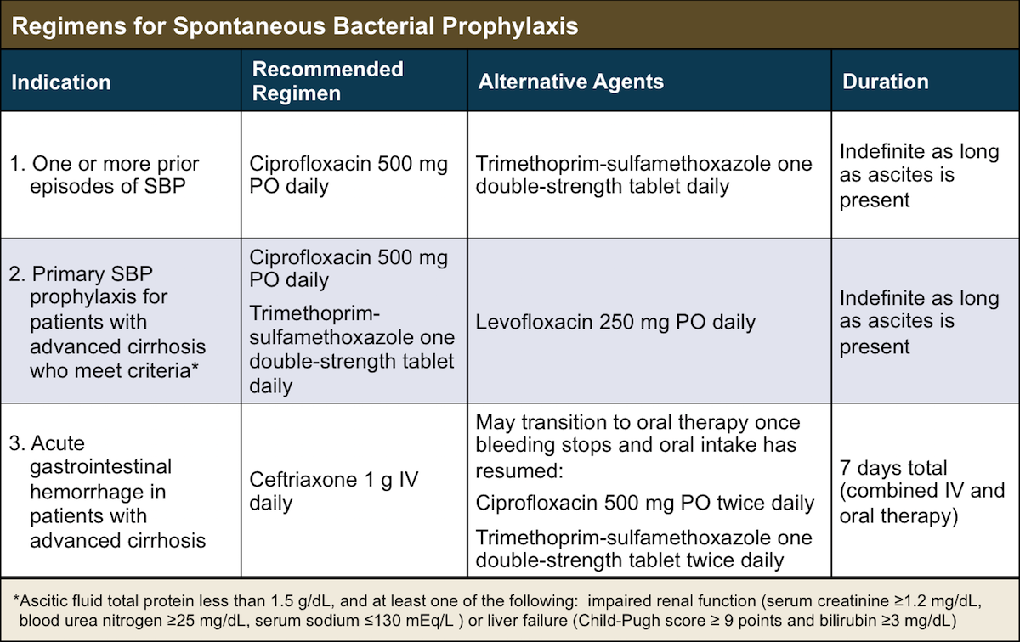

Slide 56
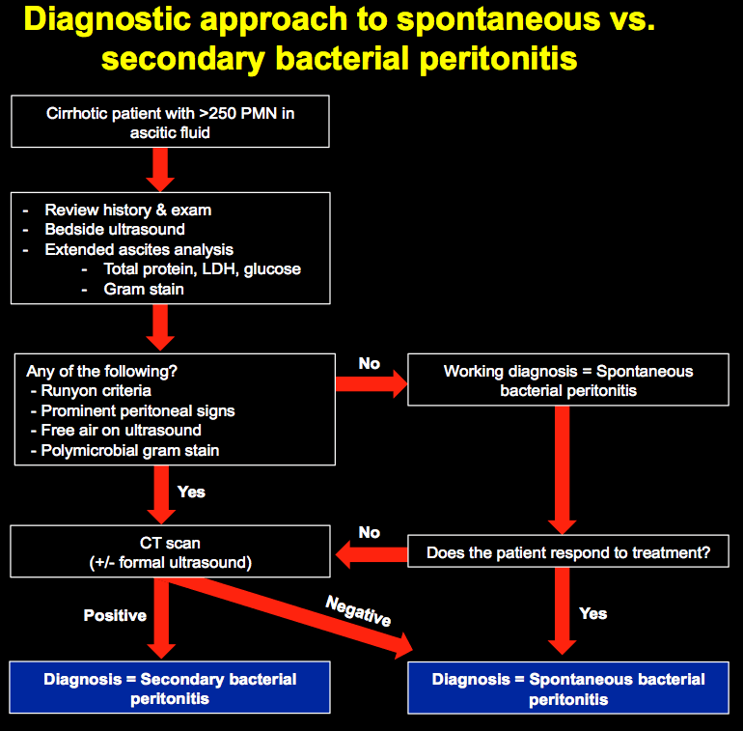

Slide 57
Runyon's criteria
For diagnosis of 2ry bacterial peritonitis: (requires two of these three features)
1- Total protein >1 g/dL,
2- Glucose <50 mg/dL
3- Lactate dehydrodgenase (LDH) above the upper limit of normal for serum

Slide 58
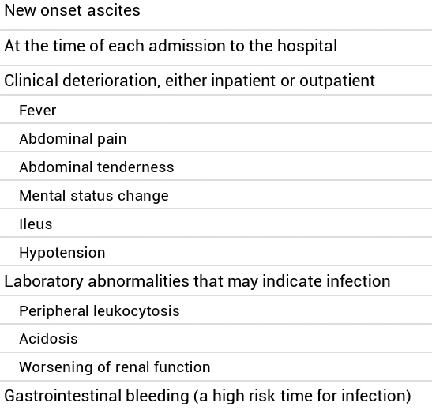
When to perform abdominal paracentesis
Diagnostic
Therapeutic
: to assess the cause of ascites & risk of SBP
(suspect SBP)
Therapeutic in tense ascites causing respiratory distress or refractory ascites

Slide 59
Quizzes

Slide 60
Quiz 1
A 55-year-old man with chronic HCV complains of fatigue. On physical examination, he has vascular spiders, palmar erythema, and a palpable left lobe of his liver. He has no ascites or asterixis. Laboratory analysis demonstrates AST 100 IU/L, ALT 67 IU/L, alkaline phosphatase 145, and platelet count of 120 x10³. Abdominal CT scan shows a nodular liver contour, portosystemic collaterals, but no masses.
What is the next step?
Liver biopsy
Upper endoscopy
Start nonselective β-blockers
Start spironolactone
Magnetic resonance imaging of the liver

Slide 61
Quiz 2
A 64-year-old obese man presents for evaluation of new ascites and peripheral edema. He has no history of liver disease. Physical examination reveals decreased breath sounds, moderate ascites, and peripheral edema but no other abnormalities. Laboratory tests reveal a total bilirubin 1.2 mg/dL, AST 37 IU/mL, ALT 35 IU/mL, albumin 3.7 g/dL, and INR of 1.4. Paracentesis discloses clear yellow fluid with the following characteristics: total protein 3.5 g/dL, albumin 1.7 g/dL, white blood cells 640/μL (12% neutrophils).

Slide 62
Quiz 2 (cont.)
Which one of the following is the most appropriate action?
Begin intravenous cefotaxime and await ascites culture results.
Perform a liver biopsy.
Obtain serum B-type natriuretic peptide and perform cardiac echocardiography.
Perform an abdominal CT scan to investigate peritoneal malignant disease.
Begin therapy for tuberculosis.

Slide 63
Quiz 3
A 69-year-old obese, diabetic man with biopsy-proven compensated cirrhosis and without a prior history of variceal hemorrhage has large esophageal varices on a screening endoscopy study.
Which of the following medications would you recommend at this point?
No specific medication
Metoprolol
Nadolol
Spironolactone
Pantoprazole

Slide 64
Quiz 4
What is the clinically significant HVPG ?
1) < 5 mmHg
2) 5 – 7 mmHg
3) 7 – 10 mmHg
4) 10-12 mmHg

Slide 65
Quiz 5
A 50-year-old farmer presents complaining of weight gain, on examination there is an abdominal distension with a fluid thrill. HBsAg & HCV Ab –ve. His rectal snip showed viable and non-viable Schistosoma ova. What is the most likely site of liver circulation increased resistance?
Pre-sinusoidal
Sinasoidal
Post-Sinasoidal
Hepatic veins
Hepatic artery

Slide 66
Quiz 6
A 44-year-old man with liver cirrhosis due to chronic hepatitis C is admitted with variceal bleeding. All of the following is recognized treatment of esophageal varices bleeding except?
TIPS
IV antibiotics
IV Octreotide
Band variceal ligation
Propranolol

Slide 67
Quiz 7
A 50-year-old male with a long history of cirrhosis secondary to chronic hepatitis C is brought to the emergency department by his son with a 2-day history of abdominal pain. On examination he was jaundiced and ascetic, BP:85/60 mmHg, No fever. Which of the following is the most common causative pathogen?
E. coli
Streptococcus
Klebsiella
‏Pseudomonas aeruginosa
Staphylococcus

Slide 68
Home message
Acute GI bleeding in patient with cirrhosis carries high rate of complications and mortality.
Patients with ascites or SBP should be considered for referral for LT.
Paracentesis is investigation of choice in SBP diagnosis.
In SBP, Antibiotic efficacy should be checked after 48 hrs.

Slide 69
References
EASL CPG decompensated cirrhosis. J Hepatol 2018;doi: 10.1016/j.jhep.2018.03.024
Goldman L, Schafer Al (Eds) (2020). Goldman-Cecil Medicine (26th ed.). Philadelphia, PA: Elsevier.
Fauci, AS, Kasper DL, Hauser SL, Longo DL, Loscalzo J (Eds.) (2018). Harrison's Principles of Internal Medicine (20th ed.). New York: McGraw-Hill Education.
Benjamin IJ, Griggs RC, Wing EJ, Fitz JG (Eds.) (2016). Andreoli and Carpenter’s Cecil Essentials of Medicine (9th ed.). Philadelphia, PA: Elsevier Saunders.
www.emcrit.org/pulmcrit/secondary-bacterial-peritonitis

Slide 70
Thank You

